Slide 1
EuroAir
Methodology of Programming (JAVA) Project

Slide 2
Group Members
Susan Koko – TYZ8PV
Guo Ruizheng – YT6WA9
Deng Zhihui – TWBGQJ
Su Haobo – C7VQKI

Slide 3
Project Summary
The proposed airline reservation system is a web based Java project
It is a comprehensive passenger processing system that includes e-ticket operations. The main features of this airline reservation system are:
Printing of E-tickets
Maintaining passenger records in database

Slide 4
Technology Stack
USERS
FrontEnd
(HTML/CSS)
BackEnd
(Java)
Database
(MySql/PHP)

Slide 5
Front End (HTML/CSS)
Welcome Page
Personal Information
Contact Details
Payment Details
Confirmation
Booking Page

Slide 6
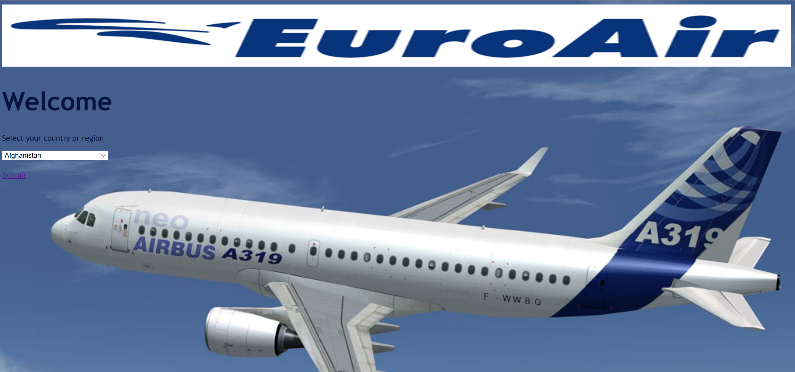
Welcome Page

Slide 7
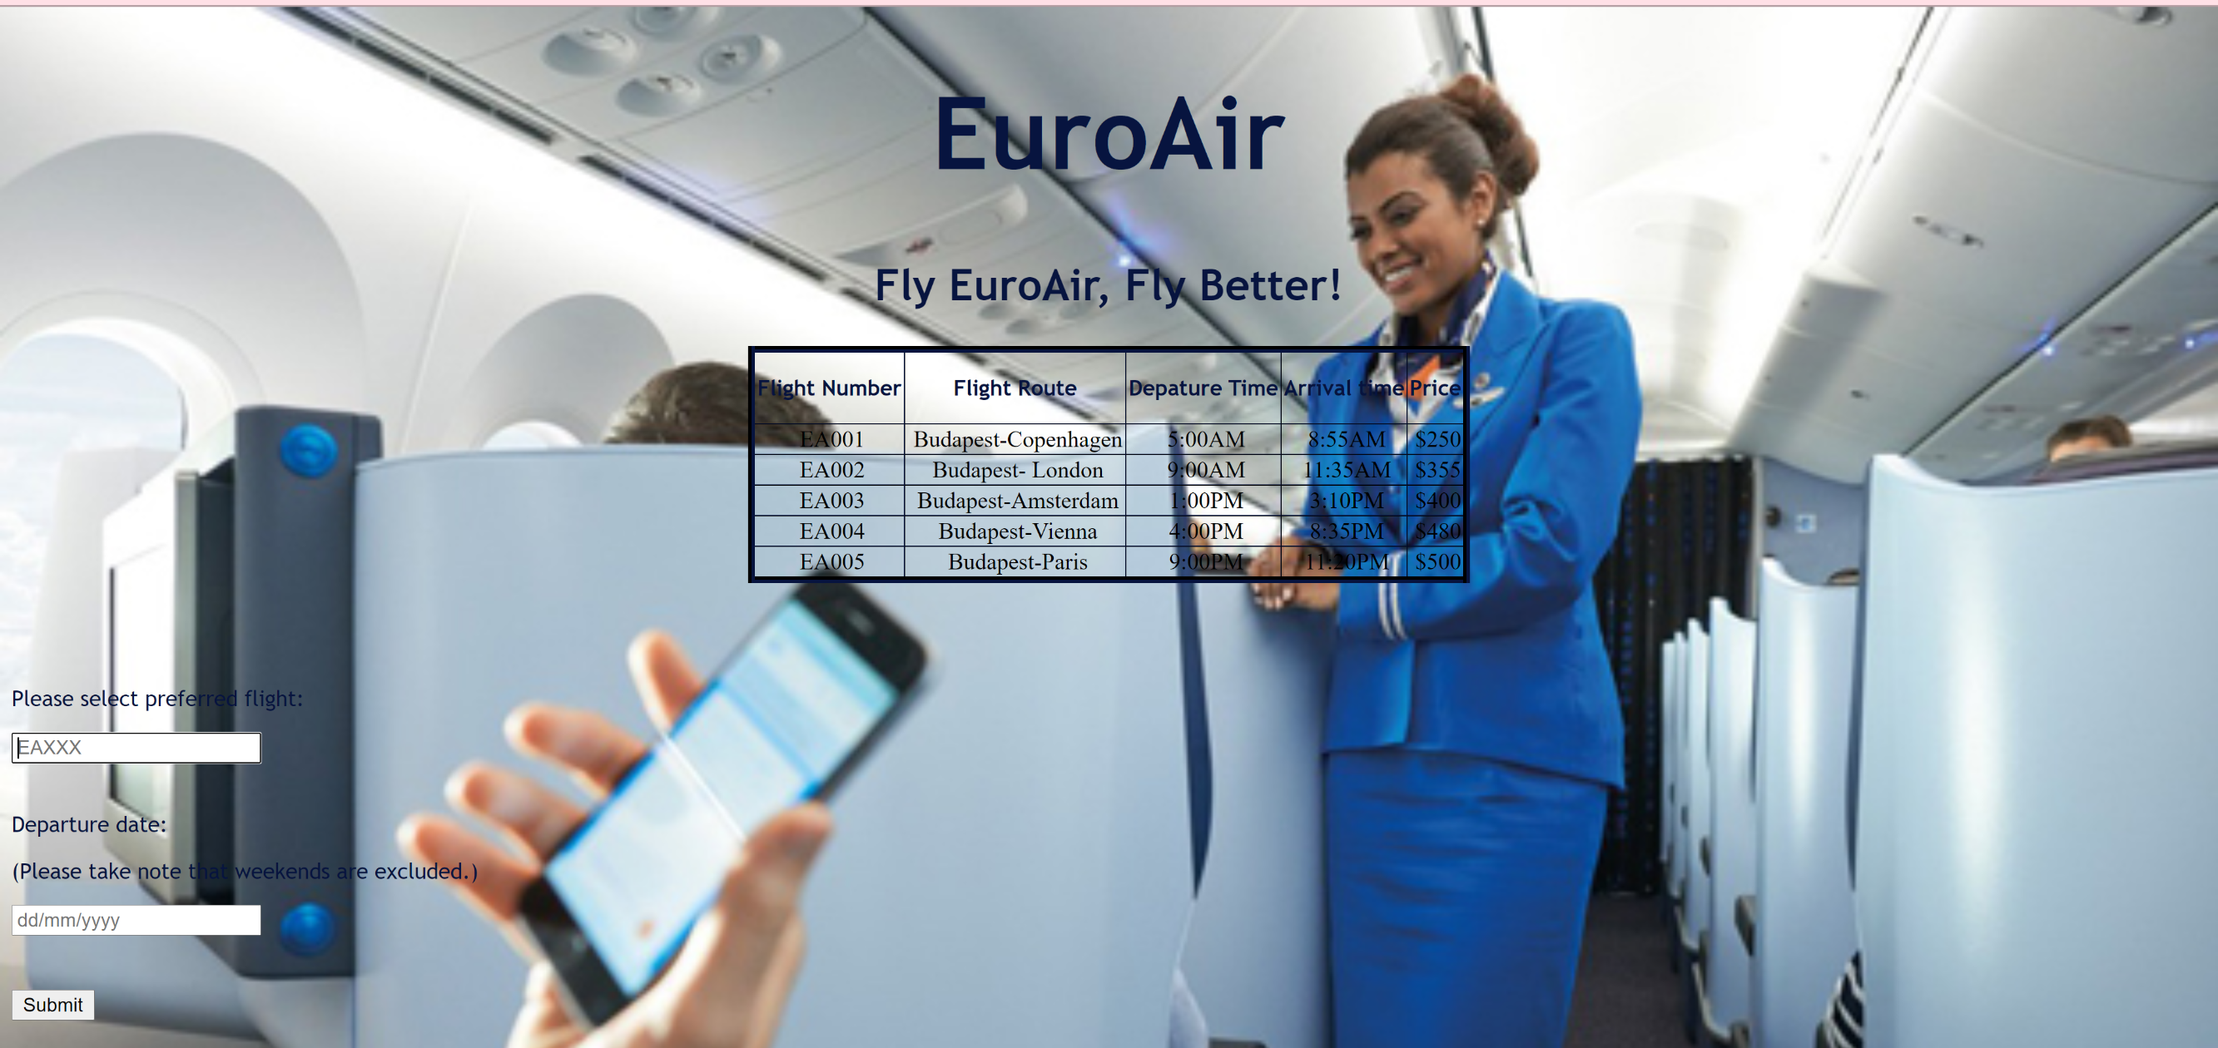
Booking Page

Slide 8
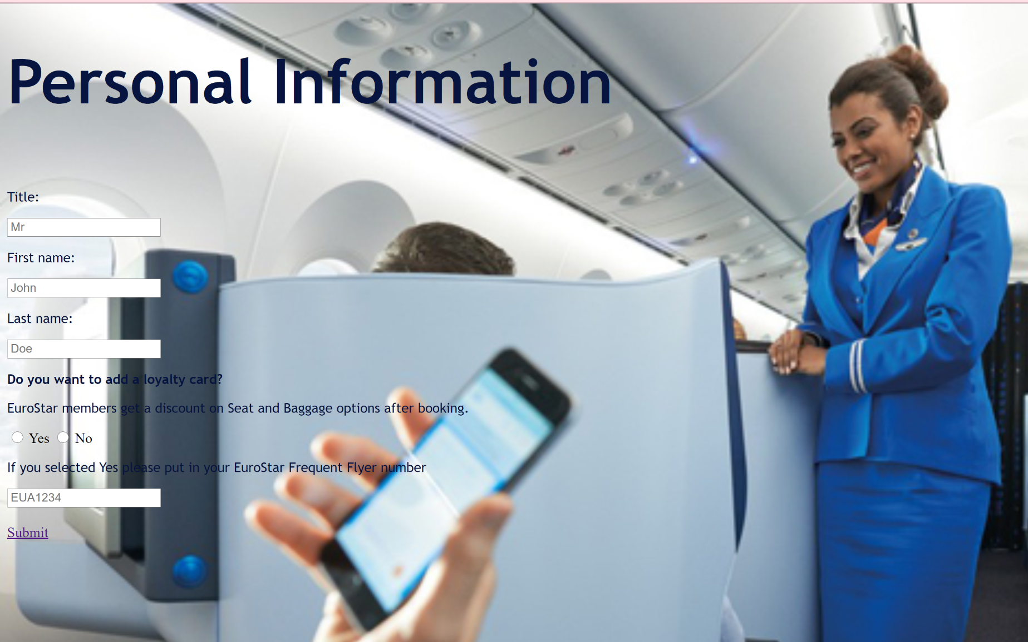
Personal Information

Slide 9
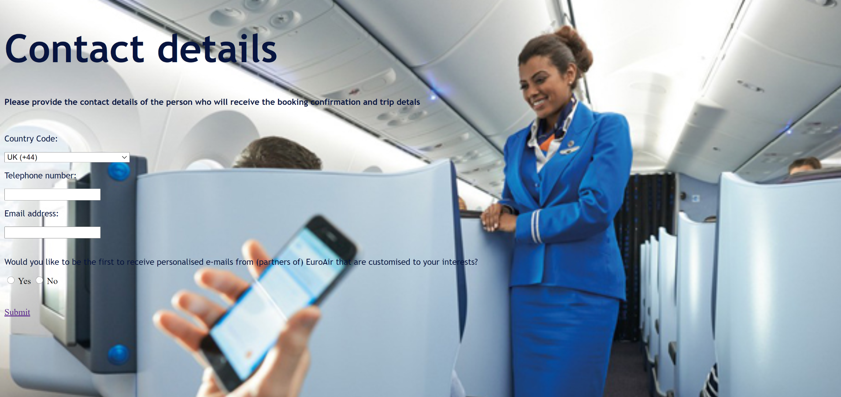
Contact details

Slide 10
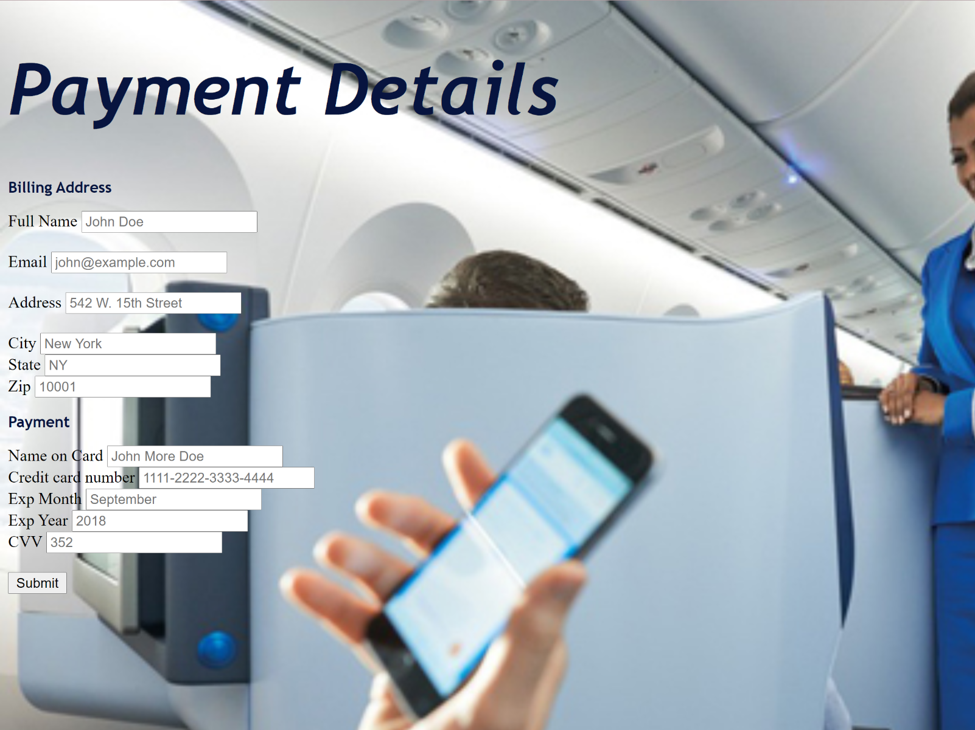
Payment Information

Slide 11
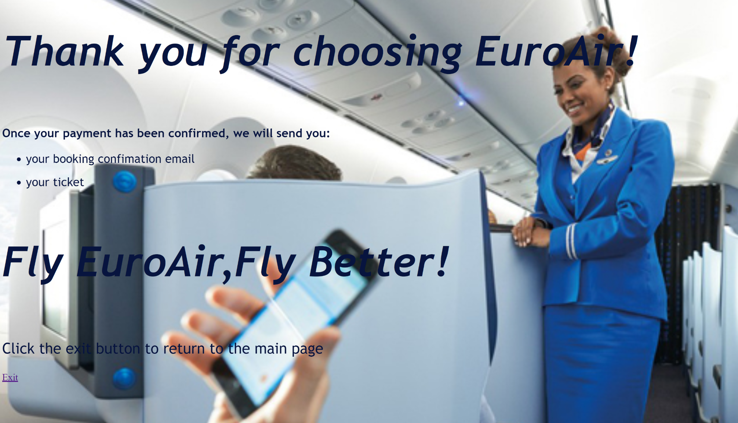
Confirmation

Slide 12
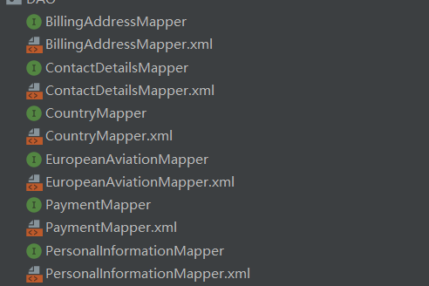
Java (SU HAOBO)
I used mybatis.MyBatis is an excellent persistence layer framework that supports custom SQL, stored procedures, and advanced mapping. MyBatis eliminates almost all JDBC code and the work of setting parameters and obtaining result sets. MyBatis can configure and map primitive types, interfaces and Java POJOs (Plain Old Java Objects) as records in the database through simple XML or annotations.

Slide 13
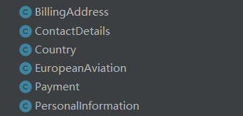
Java (SU HAOBO)
The entity corresponding to the table in the database, each entity is a column of the table

Slide 14
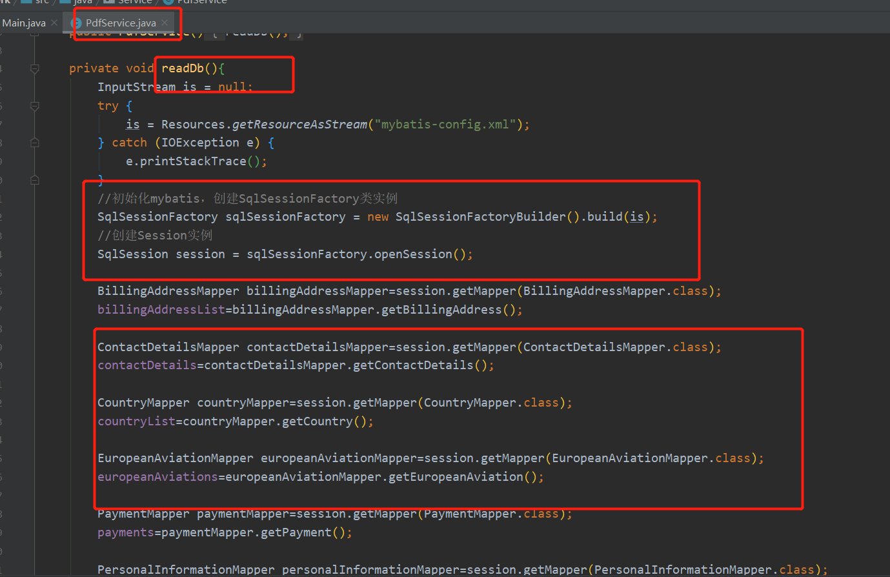
Java (SU HAOBO)
Mybatis reads data and stores it in each List

Slide 15
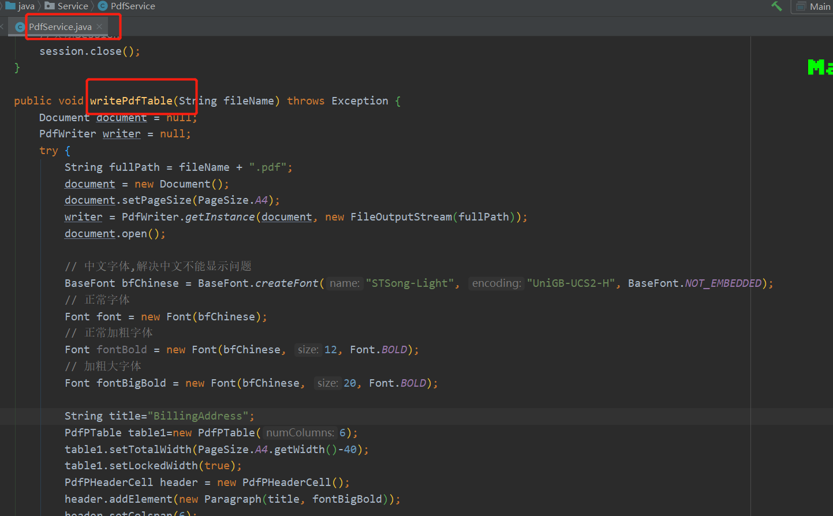
Java (SU HAOBO)
Write the read data to the pdf file, using the jar package of itextpdf

Slide 16
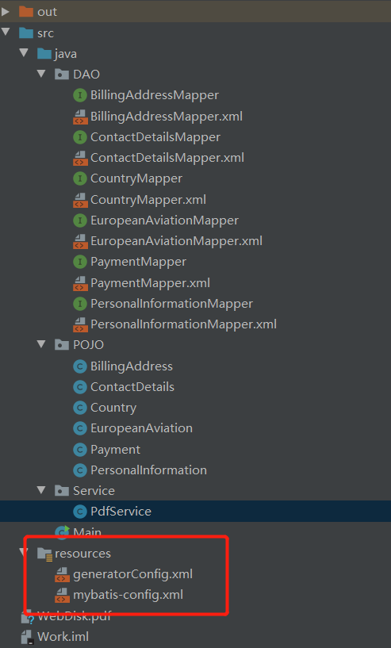
Java (SU HAOBO)
The configuration file, the first one is used to generate those files under the DAO package. It is mybatis reverse engineering. The corresponding code is generated according to the table structure in the database, without the need for human handwriting
The second file is used by jdbc to connect to the database. It contains the ip address of the database server and the type of database used, as well as the user name and password.

Slide 17
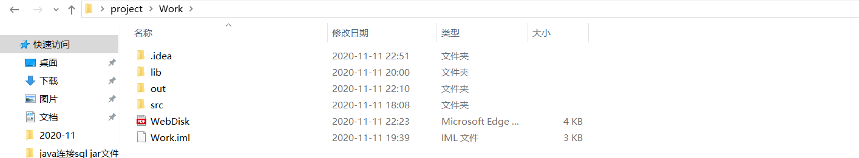
Java (SU HAOBO)
The new pdf will download in this file

Slide 18
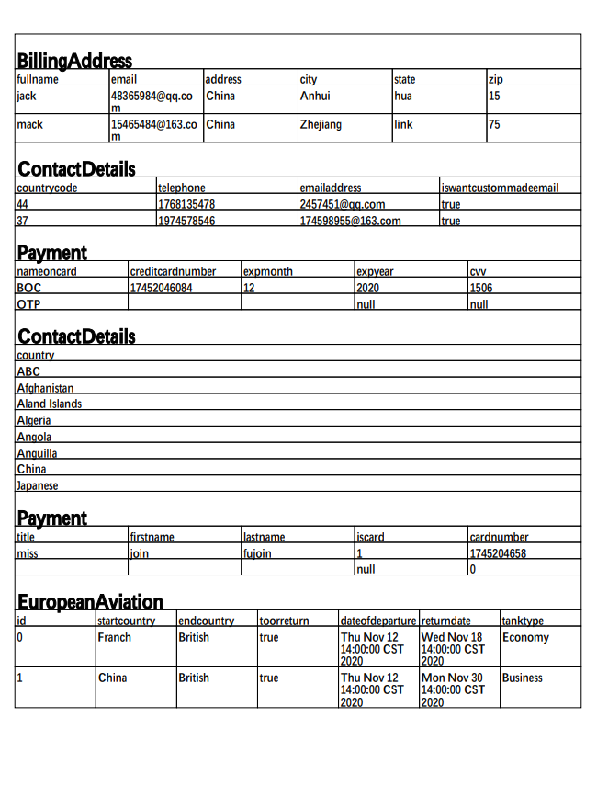
Java (SU HAOBO)
This is an example of the PDF that is generated

Slide 19
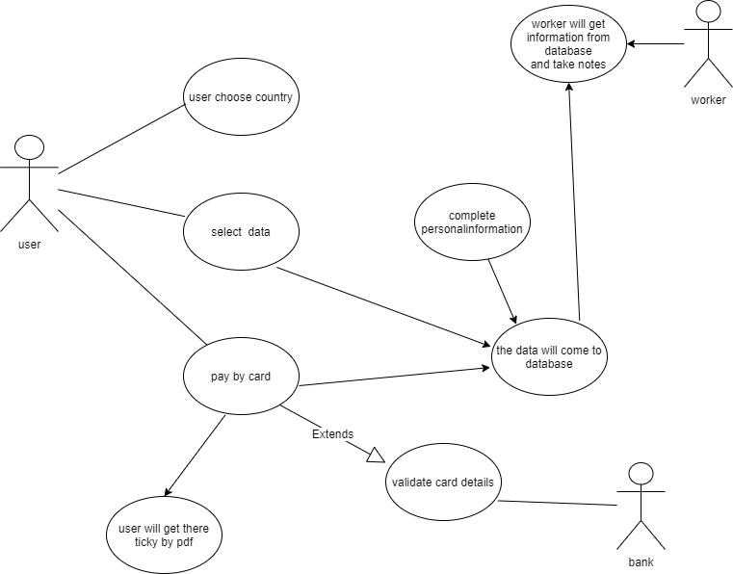
Java (SU HAOBO)
Use Case diagram

Slide 20
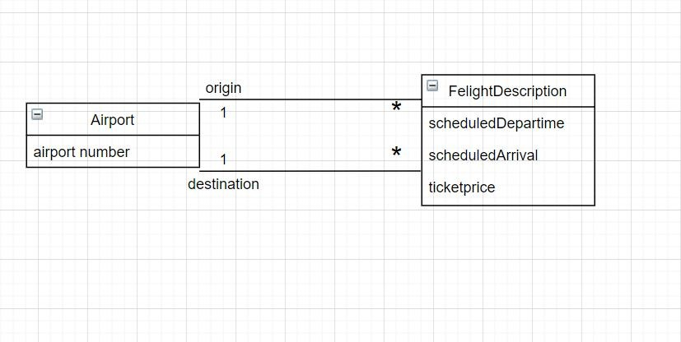
Java (SU HAOBO)
Uml class diagram

Slide 21
MYSQL (GUO RUIZHENG)
Billing Address
Country
Payment
EUROAIR
European Aviation
Contact Details
Personal Information

Slide 22
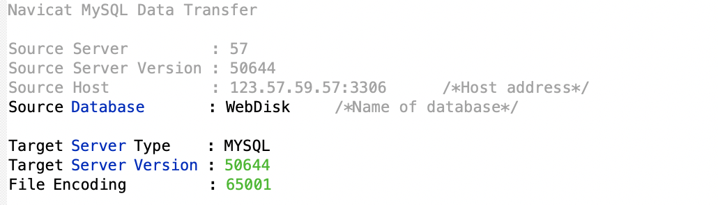
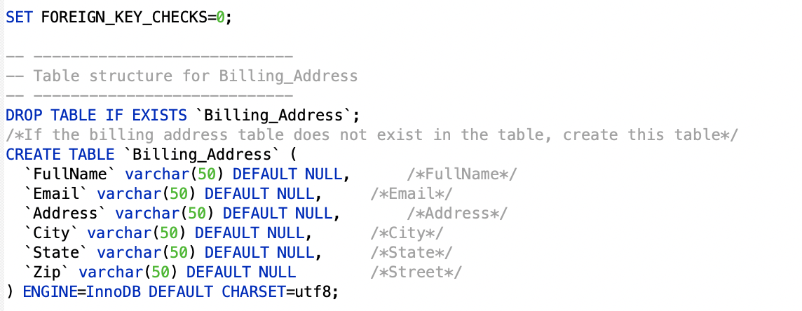
MYSQL (GUO RUIZHENG)
Basic Information setting
Create this table (Billing Address) if it does not exist

Slide 23
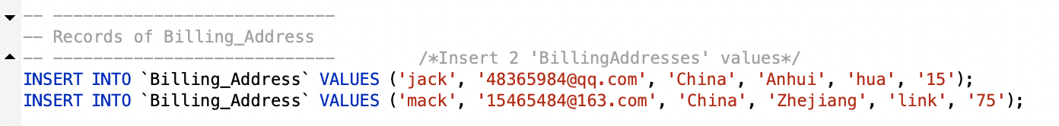
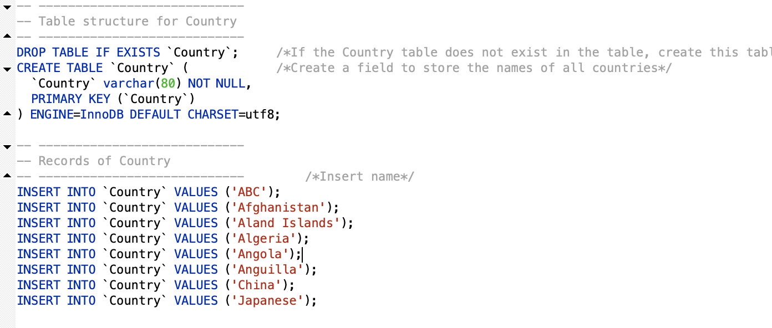
MYSQL (GUO RUIZHENG)
Enter two rows of data that match with this table
city
state
zip
Create a field to store the names of all countries

Slide 24
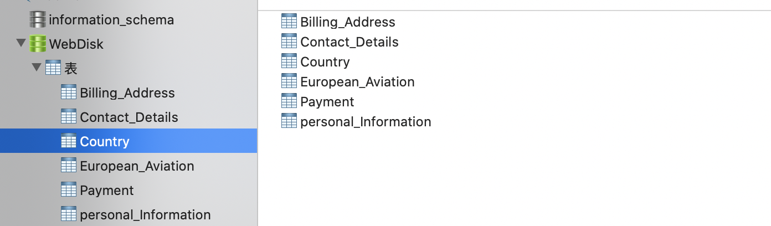
MYSQL (GUO RUIZHENG)
Example from this table(European Aviation)

Slide 25
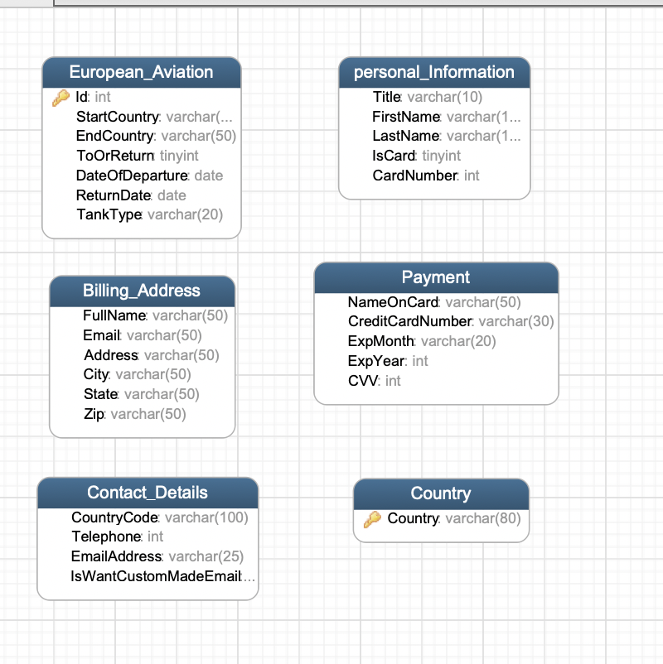
MYSQL (GUO RUIZHENG)
Details about tables
HTML
PHP
MySQL

Slide 26
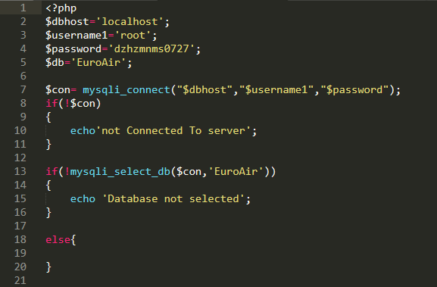
PHP (DENG ZHUHUI)
Connect to database

Slide 27
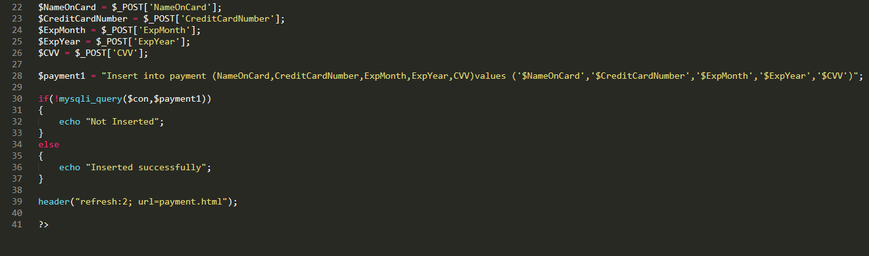
PHP (DENG ZHUHUI)
Insert Example 1 – PHP (Payment)

Slide 28
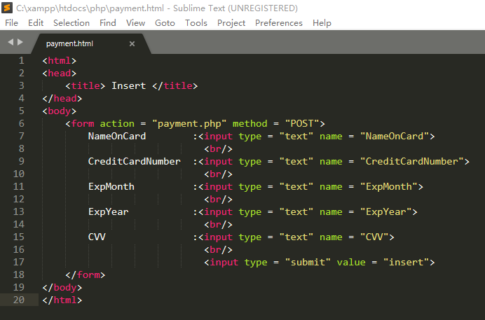
PHP (DENG ZHUHUI)
Insert Example 1 – HTML

Slide 29
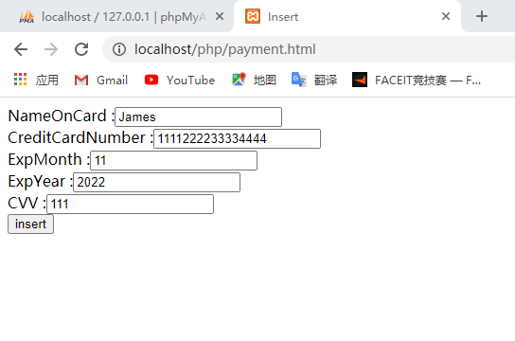
PHP (DENG ZHUHUI)
Insert Example 1 – HTML (Payment)

Slide 30
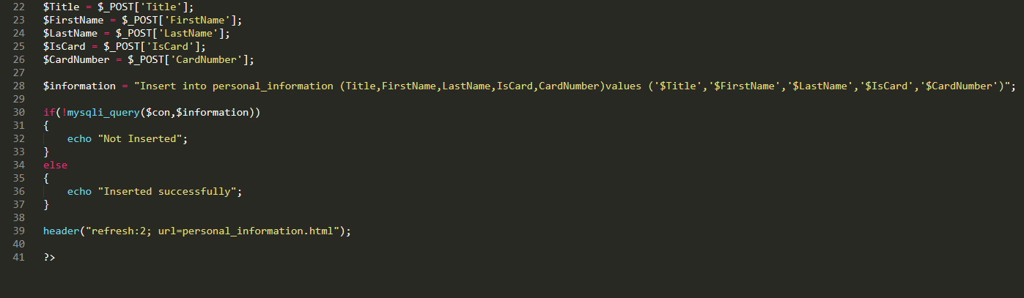
PHP (DENG ZHUHUI)
Insert Example 2 – PHP (Personal Information)

Slide 31
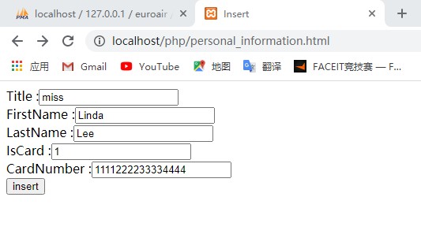
PHP (DENG ZHUHUI)
Insert Example 2 – HTML (Personal Information)

Slide 32
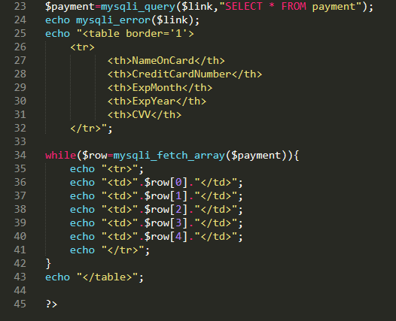
PHP (DENG ZHUHUI)
select Example 1 – (Payment)

Slide 33
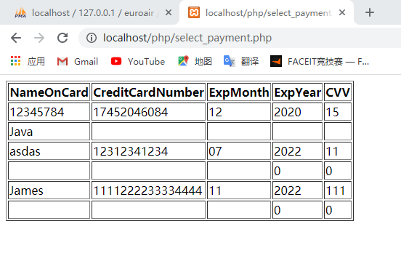
PHP (DENG ZHUHUI)
The result of select example 1

Slide 34
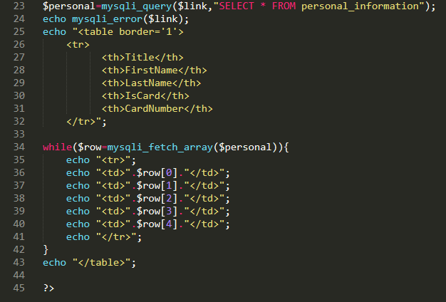
PHP (DENG ZHUHUI)
select example 2 (Personal Information)

Slide 35
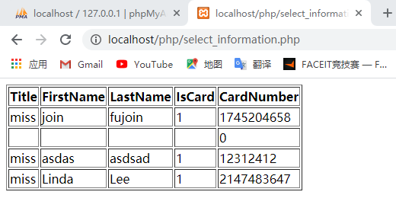
PHP (DENG ZHUHUI)
The result of select example 2

